Slide 1
We will get started shortly.
International Science Nutrition Society – CURARE CAUSAM - ISNS 2023

Slide 2
ISNS CASE STUDY
With Dr. Norbert Ketskes on Gluten Sensitivity
International Science Nutrition Society – CURARE CAUSAM - ISNS 2023

Slide 3
Medical Disclaimer
The information provided is for educational purposes and is not intended as medical advice or a substitute for the medical advice of a physician or other qualified health care professional. This is for science and educational purposes only and cannot be used in any aspect of sales or marketing. You should not use this information for diagnosing a health or fitness problem or disease. You should always consult with a doctor or other health care professional for medical advice or information about diagnosis and treatment. This is Confidential. Do not distribute—for scientific educational purposes only.
International Science Nutrition Society – CURARE CAUSAM - ISNS 2023

Slide 5
DR. NORBERT KETSKÉS, MD
Dr. Norbert Ketskés M.D. is one the most acknowledged gastroenterologist in Hungary, specializing in natural and organic nutritional solutions, leading the well-known Primus Labor, a private clinic offering personalized nutritional advices to its patients.
Scientific Adviser of ISNS
Medical Partner of the Hungarian Olympic Committee since 2015
Member of the Medical board of Hungarian Karate Association since 2015
Leader of the Primus Labor Private Medical Clinic since 2013
Working as a Family Doctor 1999 – 2012
International Science Nutrition Society – CURARE CAUSAM - ISNS 2023

Slide 6
CSISZTU ZSUZSA
Television - Presenter, Anchor, Editor, Journalist and Sports Lawyer, Sport-diplomat
Spokesperson of the Giro d’Italia Grande Partenza, (Road-Cycling World -Tour Championship)
Spokesperson of the FINA (Swimming and Waters poets World Championship)
2022 Vice-President of the Hungarian Sports Journalists’ Association
Member of the Hungarian Olympic Committee Member of the Advisory Board of the Hungarian Olympic Academy
Newly Elected Vice-President of the International Sports Journalists Association, the first female ever in the field from her homeland, and third globally since 1924 (AIPS)
International Science Nutrition Society – CURARE CAUSAM - ISNS 2023

Slide 7
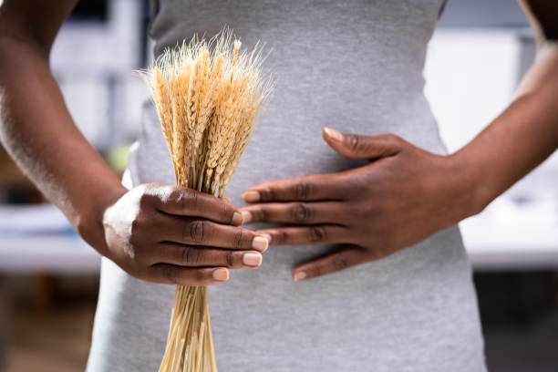
What is Gluten Sensitivity?
Gluten intolerance, or gluten sensitivity, is a disorder where your body reacts badly to eating gluten, a protein found in wheat, rye, and barley grains. Gluten intolerance has some of the same symptoms as celiac disease but doesn’t cause permanent damage to your small intestine. Celiac disease is an autoimmune disease that is hereditary (runs in the family)
International Science Nutrition Society – CURARE CAUSAM - ISNS 2023

Slide 8
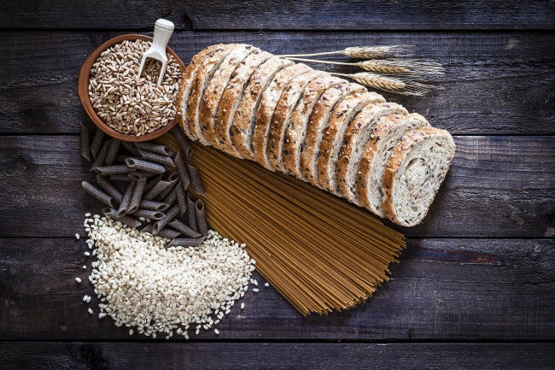
What is Gluten?
Gluten is a protein found in wheat, barley, rye, and other grains. It can be found in common foods, including pasta, cereal, and beer. Gluten allows food to maintain its shape by acting as a glue. Gluten can also be in things like vitamins, cosmetics, and even certain medications.
International Science Nutrition Society – CURARE CAUSAM - ISNS 2023

Slide 9
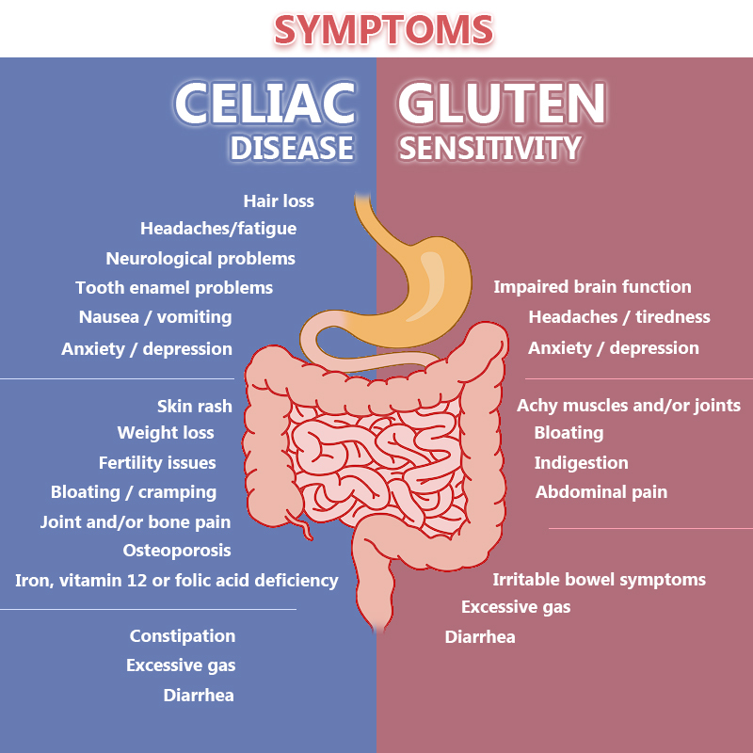
Is Gluten Intolerance and Celiac Disease the Same?
Gluten intolerance and Celiac Disease are different. People with Celiac Disease have an autoimmune response to gluten. This means their bodies try to fight against gluten as if it were a virus. This reaction causes inflammation and damage to their digestive tracts.
International Science Nutrition Society – CURARE CAUSAM - ISNS 2023

Slide 10
What Causes Gluten Intolerance?
The exact causes of gluten intolerance are not well understood. Research shows that people may not be sensitive to gluten but sensitive to a certain carbohydrate found in many foods. Their bodies do not absorb the carbohydrates and stay in their gut and ferment causing sickness.
Other research suggests that wheat might affect the lining of the digestive tract. This lining usually keeps bacteria from leaking out of the intestines. In people with a gluten intolerance, the lining may not work as it should, allowing bacteria into their blood or liver and causing inflammation.
International Science Nutrition Society – CURARE CAUSAM - ISNS 2023

Slide 11
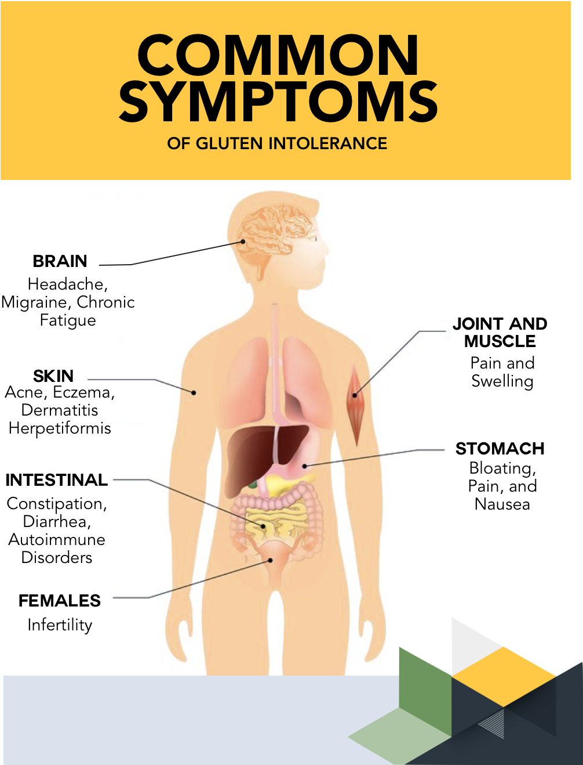
What are the symptoms of Gluten Intolerance?
People may experience the following symptoms for several hours or days after consuming gluten:
Abdominal Pain
Anemia
Anxiety
Bloating or gas
Brain fog, or trouble concentrating
Depression
Diarrhea or constipation
Fatigue
Headache
Joint pain
Nausea and vomiting
Skin rash
Many people with gluten intolerance also have irritable bowel syndrome (IBS).
International Science Nutrition Society – CURARE CAUSAM - ISNS 2023

Slide 12
How is Gluten Intolerance Diagnosed?
Your healthcare provider will carefully review your symptoms and medical history. If they suspect you have a gluten intolerance, these are the next steps to confirm your diagnosis.
You will eat a diet containing gluten for 6 weeks. During this time, your doctor will perform blood tests and skin tests to rule out a wheat allergy or celiac disease. There is not a gluten intolerance test available at this time.
If you do not have a wheat allergy or celiac disease, your healthcare provider will ask you to exclude gluten from your diet for at least 6 weeks. You will keep a thorough record of your symptoms during this time, noting which (if any) symptoms improve.
If your symptoms do improve while you are on a gluten-free diet, you will gradually reintroduce gluten back into your diet. If symptoms return, you likely have a gluten intolerance.
International Science Nutrition Society – CURARE CAUSAM - ISNS 2023

Slide 13
CASE STUDY
Patient: Female
Age: 38
Medical history:No significant medical issues in the past.
Symptoms:
She has been experiencing recurring gastrointestinal discomfort for the past one year. Her symptoms include bloating, abdominal pain, gas, diarrhea, and occasional headaches. She noticed that these symptoms tend to occur after consuming meals containing wheat-based products like bread, pasta, and cereal. These symptoms have become more frequent and are affecting her daily life, causing her to miss work occasionally.
Diagnostic process:
Blood Tests: Negative for celiac disease, but the lab showed signs of iron defiency ( Fe: 7,7 mikromol/l norm. Range:10,7-32,2)
Endoscopy: Biopsy,
Elimination Diet: To confirm the diagnosis, doctor recommended an elimination diet. She was asked to remove all gluten-containing foods from her diet for 6 weeks. During this period, her symptoms significantly improved.
Her symptoms have not completely resolved!!!
International Science Nutrition Society – CURARE CAUSAM - ISNS 2023

Slide 14
Conventional Treatment
There is no cure for gluten intolerance. Most people find relief from symptoms by following a gluten-free diet. You should work with your healthcare provider and a dietician to plan your diet.
You can also ask your healthcare provider about adding probiotics to your diet. Probiotics help increase the good bacteria in your gut. They may reduce symptoms of bloating, gas, or constipation.
Some research suggests that taking certain enzymes may help your digest gluten. Experts are still investigating this treatment.
----------------------------------------------------------------------
Gluten-Free Diet: She was advised to continue following a gluten-free diet, eliminating all sources of gluten from her meals and snacks. This meant avoiding foods like wheat, barley, rye, oats and their derivatives. She was educated about reading food labels carefully to identify hidden sources of gluten.
International Science Nutrition Society – CURARE CAUSAM - ISNS 2023

Slide 15
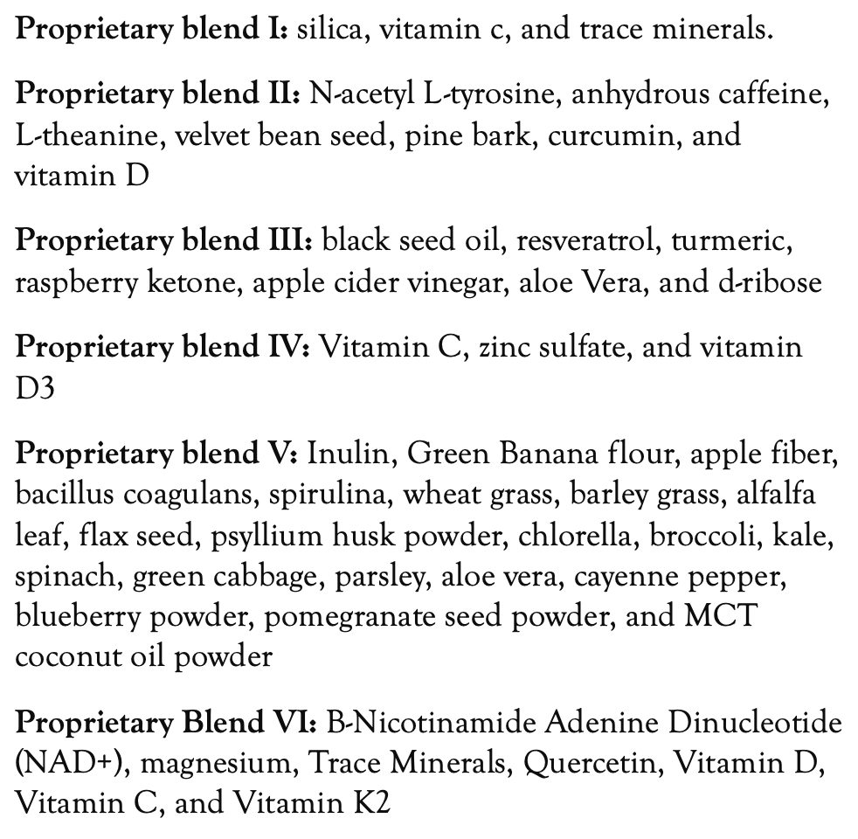
Method
PROPRIETARY BLENDS LEGEND
Proprietary blend I: 2x5 drops, morning and
evening, for 3 days, then every 3 days then
increased by 1-1 drops every 3 days to 2x10
Proprietary blend III: 1/2 sachet in the morning
for 7 days then 1 sachet in the morning for 7 days
then 1 sachet in the morning and 1 sachet in the
evening
Proprietary blend IV: 1/2 teaspoon in the
morning
Proprietary blend V: 1 teaspoon in the
in the evening for 7 days, then 1,5 teaspoon in
the evening
Proprietary blend VI: 1 in the
morning for 7 days then 1 in the morning and 1 in
the evening
International Science Nutrition Society – CURARE CAUSAM - ISNS 2023

Slide 16
Additional Treatment
Exercises to achieve a positive mental and emotional state
(e.g: Yoga, meditation, breathing exercises, stress management, regular exercise and adequate sleep)
International Science Nutrition Society – CURARE CAUSAM - ISNS 2023

Slide 17
Results
After 1 month:
Her bloating, abdominal pain, gas, and diarrhea became less frequent, and her headaches occurred less often.
After 2 months:
Her symptoms are completely gone.
Her quality of life improved, and she was able to return to work without disruptions.
The iron deficiency condition has normalized.
Fe: 11 mikromol/l (7,7) (norm. Range:10,7-32,2)
International Science Nutrition Society – CURARE CAUSAM - ISNS 2023

Slide 18
Research Studies
International Science Nutrition Society – CURARE CAUSAM - ISNS 2023

Slide 19
Non- Celiac Gluten Sensitivity and Protective Role of Dietary Polyphenols Nadia Calabriso, Egeria Scoditti, Marika Massaro, Michael Maffia, Marcello Chieppa, Barbara Laddomada, and Maria Annunziata Carluccio
Pathogenetically characterized by the absence of celiac disease and wheat allergy, non-celiac gluten sensitivity (NCGS) is a clinical entity triggered by the consumption of gluten-containing foods th
it is very difficult to maintain a complete gluten-free diet, there is a high interest in discovering alternative strategies aimed at reducing gluten concentration or mitigating its toxic effects. Plant-based dietary models are usually rich in bioactive compounds, such as polyphenols, recognized to prevent, delay, or even reverse chronic diseases, including intestinal disorders. at relieved by a gluten-free diet.
We analyze the potential targets of polyphenols including the gluten peptide bioavailability, the dysfunction of the intestinal epithelial barrier, intestinal immune response, oxidative stress and inflammation, and dysbiosis
Polyphenols can exhibit a direct action of capturing gluten, the main trigger of gluten-related diseases such as NCGS, thereby reducing its bioavailability and associated toxic effects. Polyphenols can also dampen the toxic effects of gluten, both at the intestinal and systemic levels, by reducing oxidative stress and inflammation, by regulating the immune response, and by improving the health of the intestinal microbiota and the function of the intestinal barrier.
https://www.mdpi.com/2072-6643/14/13/2679
International Science Nutrition Society – CURARE CAUSAM - ISNS 2023

Slide 20
References
https://my.clevelandclinic.org/health/diseases/21622-gluten-intolerance
https://www.mdpi.com/2072-6643/14/13/2679
https://www.ncbi.nlm.nih.gov/pmc/articles/PMC6630947/
International Science Nutrition Society – CURARE CAUSAM - ISNS 2023

Slide 21
Thank You for Joining Us This Week!!
International Science Nutrition Society – CURARE CAUSAM - ISNS 2023

